Slide 1
Cognitive Load Theory

Slide 2

Common issue – information overload
Input
Processing
Storage
Sensory
Memory
Working
Memory
Long-term
Memory
< 1 second
< 1 minute
Up to a lifetime
We have a large “hard drive” for storage
Limited memory capacity for processing unfamiliar information.
Input or stimuli is held temporarily in our unconscious for less than a second until it is discarded or chosen for further processing
When something catches our attention our conscious working memory acts like a CPU where it examines the information and encodes it for storage in long-term memory
Working memory acts as a gatekeeper for new information so we should understand how it can become overloaded.

Slide 3
Cognitive load theory (CLT)
John Sweller (1988)
Intrinsic load
Inherent difficulty or complexity of the topic.
Depends on the subject matter being shared
Some topics are naturally harder to understand
Extraneous load
Effort associated with the non-relevant instructional elements that aren’t essential to learning
Because there is a finite capacity for working memory, any time spent on processing nonessential items (clutter) means less time for comprehension
Germane load
The actual effort spent on processing and organizing information for long-term memory.
Any type of learning will take effort

Slide 4
Managing intrinsic load
Break up findings into manageable segments or chunks
Reveal data gradually so your audience has time to digest and remember
Start with simple concepts and build to more complex subjects
Determine the audience’s understanding and plan ahead
Notes:
Retention rate example

Slide 5
Managing intrinsic load
Use effective chart types to convey your information
Remove irrelevant data or redundant charts
Don’t combine multiple data points into a single chart
Simple is better
Avoid dense text in slides, charts and infographics
Notes:
Retention rate example

Slide 6
Managing intrinsic load
Sort, group or label your data for easier consumption
Organize or lay out your content in a manner that is easy to follow
Share your data in a consistent manner (naming conventions, colors, symbols).
Notes:
Retention rate example

Slide 7
Managing intrinsic load
Remove nonessential chart elements (unnecessary 3D effects, dark gridlines and nonstrategic use of color)
Signal to the audience where they should focus their attention
Notes:
Retention rate example

Slide 8
Maximizing germane load
Incorporate analogies to make complex concepts approachable.
Include specific, concrete examples that can help bring overall findings to life for the audience.
Then show the overall scale of that example.
When too much information is shared, the data story can crumble under the weight of your data.
Your data story might need less than half the evidence you think it does.
As you reduce the noise, the signal will strengthen.
All you need is a few reliable, sturdy building blocks of data to form the foundation of a powerful data story.

Slide 9
Maximizing germane load
Incorporate analogies to make complex concepts approachable.
Include specific, concrete examples that bring findings to life for the audience, show the overall scale of that example.
When too much information is shared, the data story can crumble under the weight of your data.
Notes:
Retention rate example

Slide 10
Maximizing germane load
Your data story might need less than half the evidence you think it does.
As you reduce the noise, the signal will strengthen.
All you need is a few reliable, sturdy building blocks of data to form the foundation of a powerful data story.
Notes:
Retention rate example

Slide 11

Clutter

Slide 12
clutter
Visual elements that take up space but don’t increase understanding
One way to think about this is the data-ink or signal-to-noise ratio
Data Ink = any element (or “ink”) used to present data
Data-ink
Data-ink ratio =
Total ink used to print the graphic
Represents the proportion of the graphic dedicated to the non-redundant display of information

Slide 13
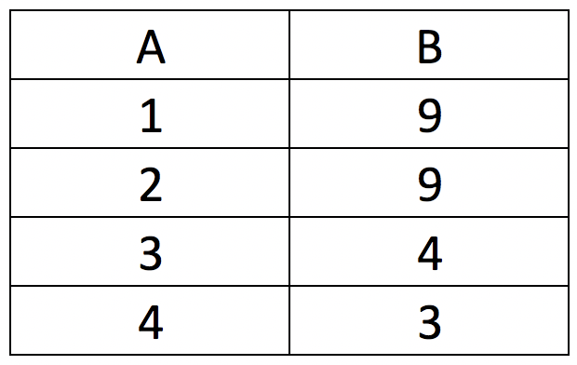
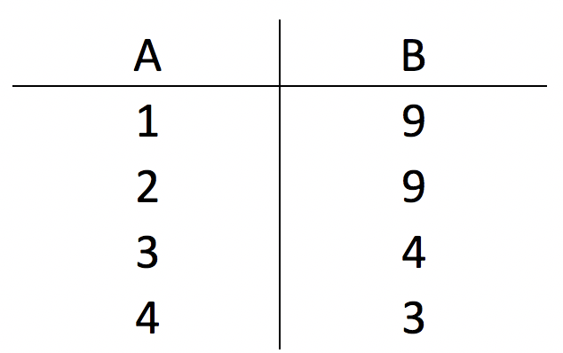
Data ink example
Low data-ink ratio
High data-ink ratio

Slide 14
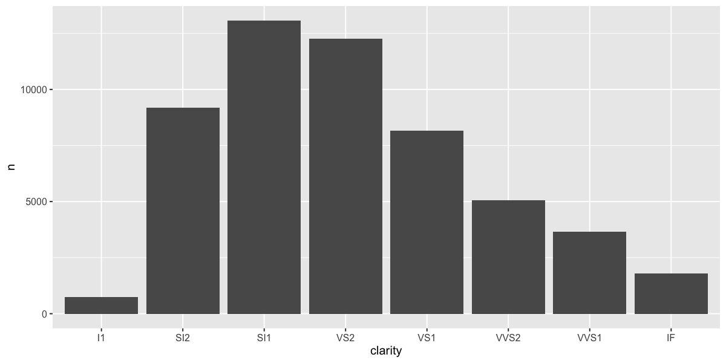
Default chart using ggplot

Slide 15
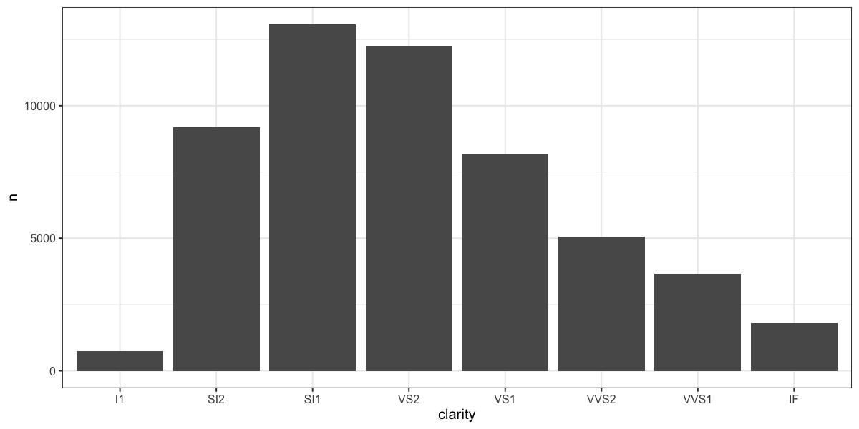
Apply a theme (better)

Slide 16

Theme with fewer visual elements

Slide 17

Gestalt Principles

Slide 18
Gestalt principles
In the 1900’s the Gestalt School of Psychology set out to understand how people perceive order in the world around them.
Gestalt Principles:
Proximity
Similarity
Enclosure
Closure
Continuity
Connection
These principles of visual perception are still accepted today and define how people interact with and create order out of visual stimuli.
Why is this important for data visualization?
Helps you communicate effectively
Creates visual order (will continue to be a topic)

Slide 19

proximity
We tend to think of objects that are physically close together as belonging to a part of a group.
Where do we see this in data visualization?
Proximity Principle

Slide 20

Proximity (cont)
Eyes are draw either down the rows (on the right) or across columns (on the left)
Proximity Application

Slide 21
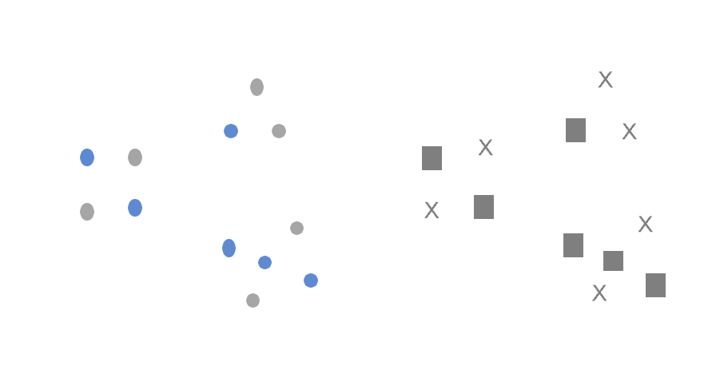
similarity
Objects that are of similar color, shape, size, or orientation are perceived as related or belonging to part of a group.
Where do we see this in data visualization?
Similarity Principle

Slide 22

Similarity (Cont)
The similarity of the color is a cue for us to read across the rows (rather than down the columns)
Similarity Application

Slide 23
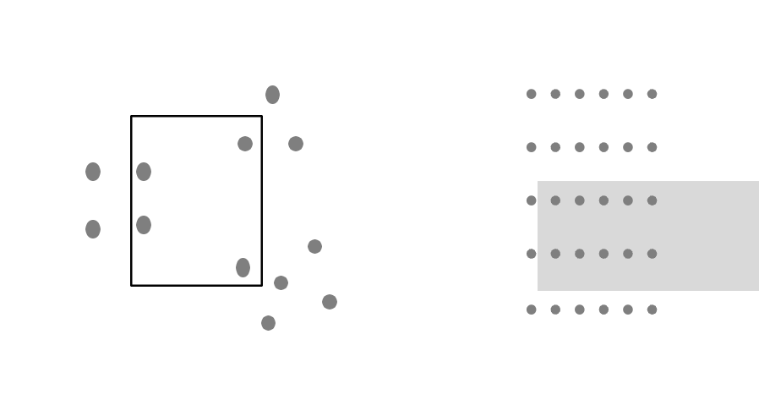
enclosure
Objects that are physically enclosed together to belong to a group.
It doesn’t take a strong enclosure to do this, shading may be sufficient.
To an extent, overrides the proximity gestalt.
Where do we see this in data visualization?
Enclosure Principle

Slide 24
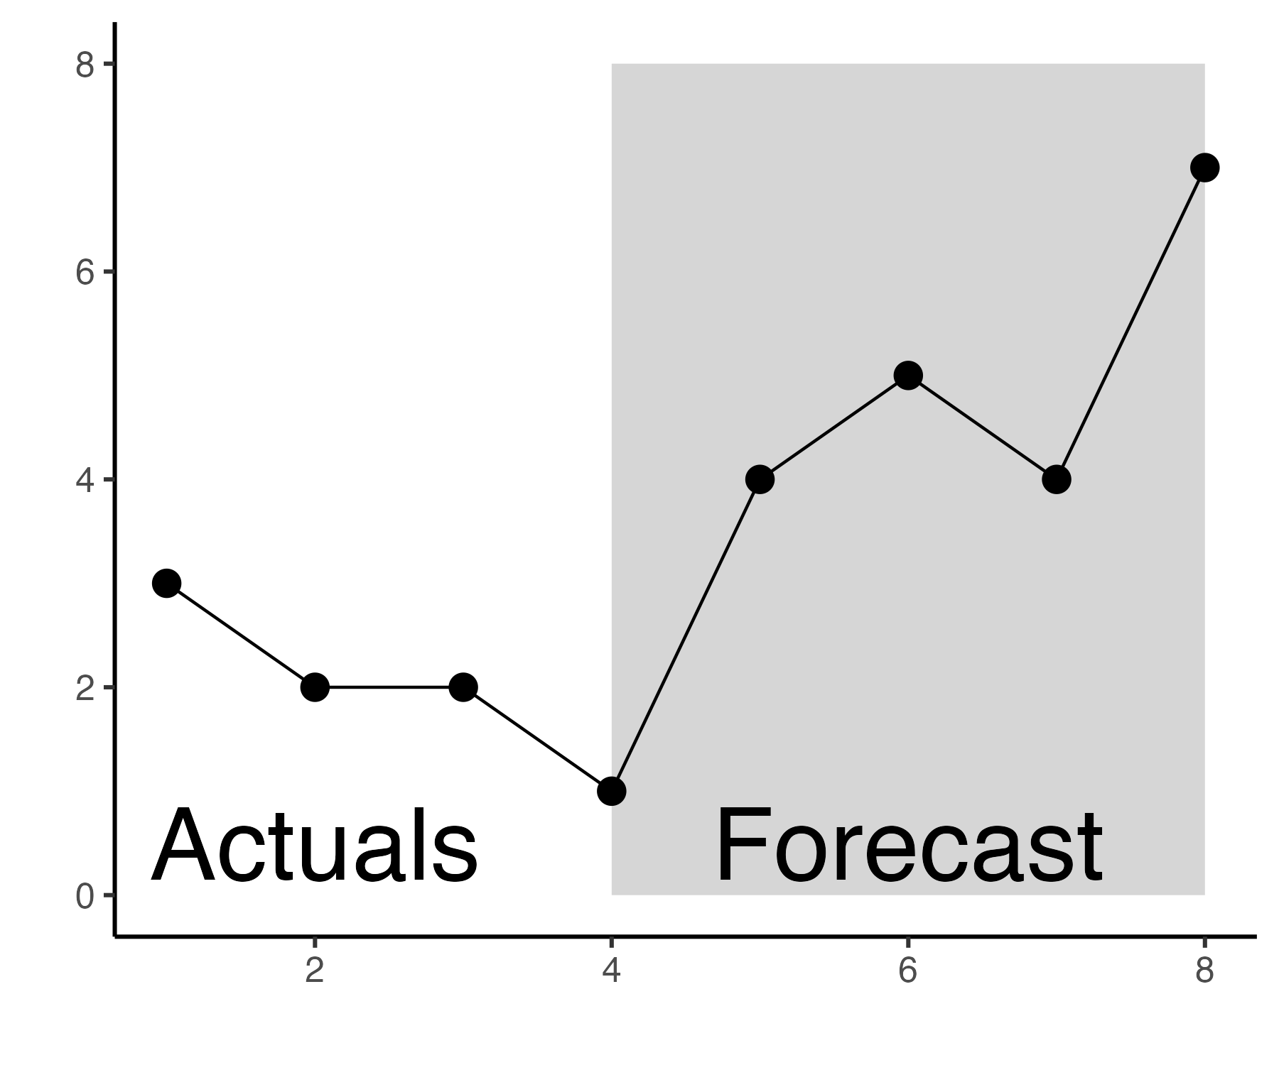
Enclosure (cont)
One way we can leverage enclosure is to draw a visual distinction within our data.
This groups data points together visually.
Appears stronger than if the points were a different color.
Enclosure Application

Slide 25
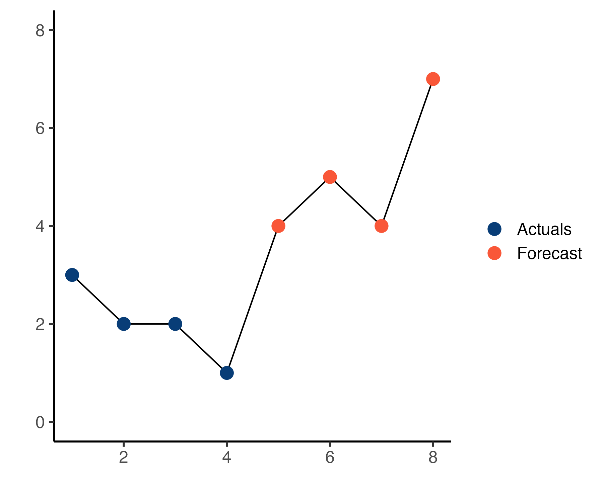
Enclosure vs similarity

Slide 26

closure
The closure principle means that people like things to be simple and to fit inside known constructs.
Because of this, we tend to see a set of individual elements as as single, recognizable shape when we can.
When pieces of a whole are missing, we fill in the missing pieces.
Where do we see this in data visualization?
Closure Principle

Slide 27
Closure example
Many charting tools include borders or shading.
The Closure principle tells us that these are very likely unnecessary.

Slide 28
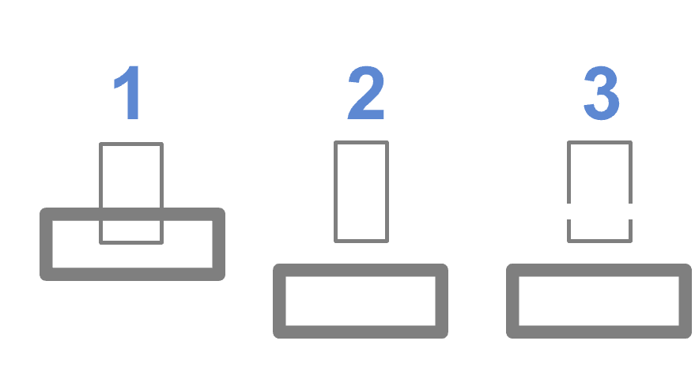
continuity
Continuity is similar to closure: when looking at objects, our eyes seek the smoothest path and naturally create continuity in what we see, even where it might not exist.
Continuity Principle

Slide 29
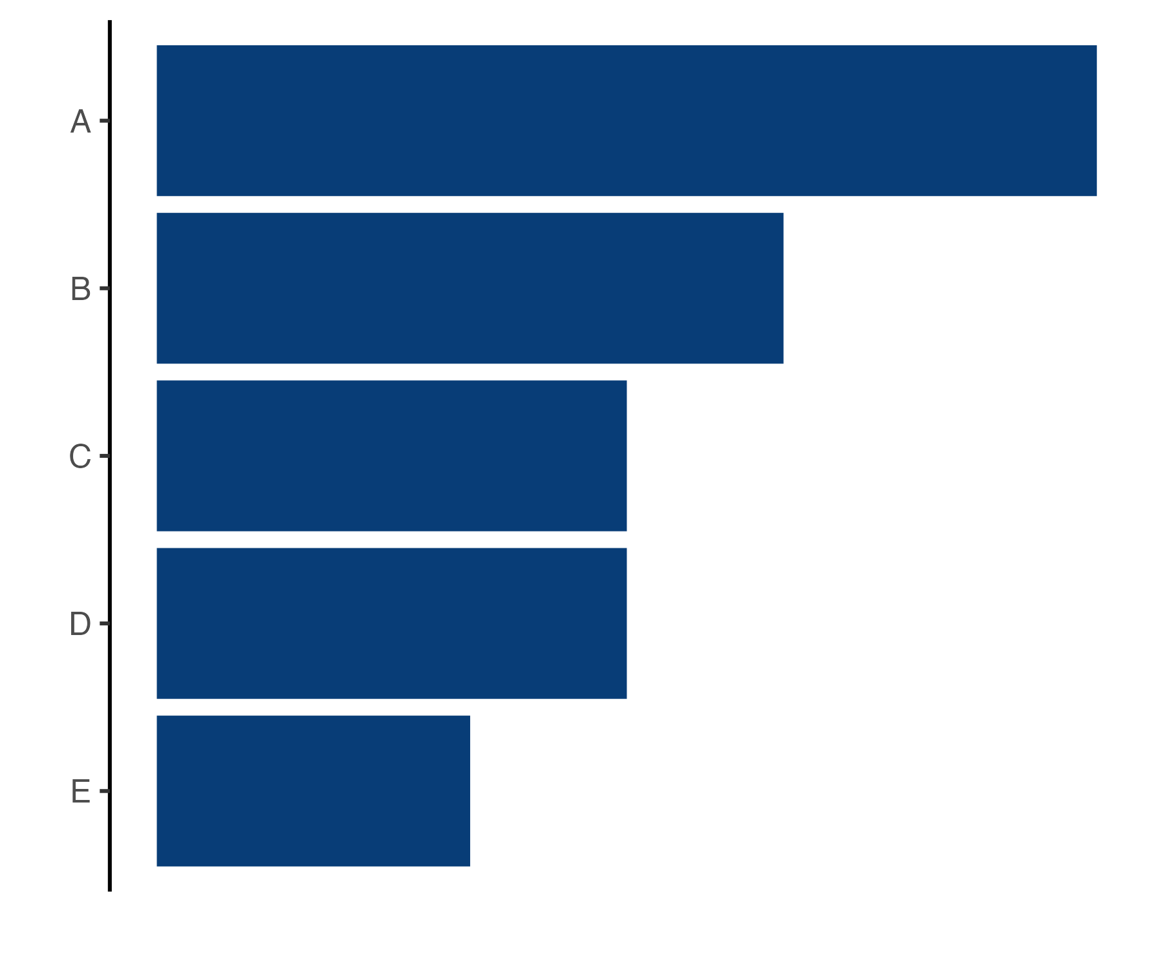

Continuity example
The Continuity Principle tells us that the vertical line is not necessary.
Our eyes still see that the bars are lined up at the same point.

Slide 30
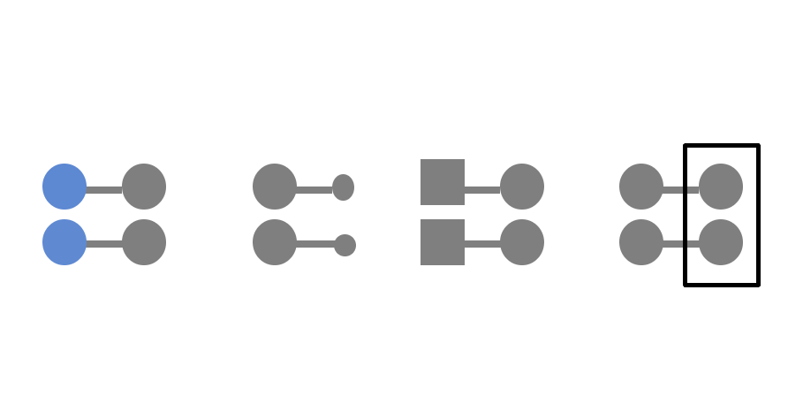
connection
Things that are physically connected are part of a group.
Connection can be used to override other Gestalts like similarity.
We perceive the things connected as part of a group, even though the color or shape might be different.
Enclosure being used in the last to override connection.
Connection Principle

Slide 31
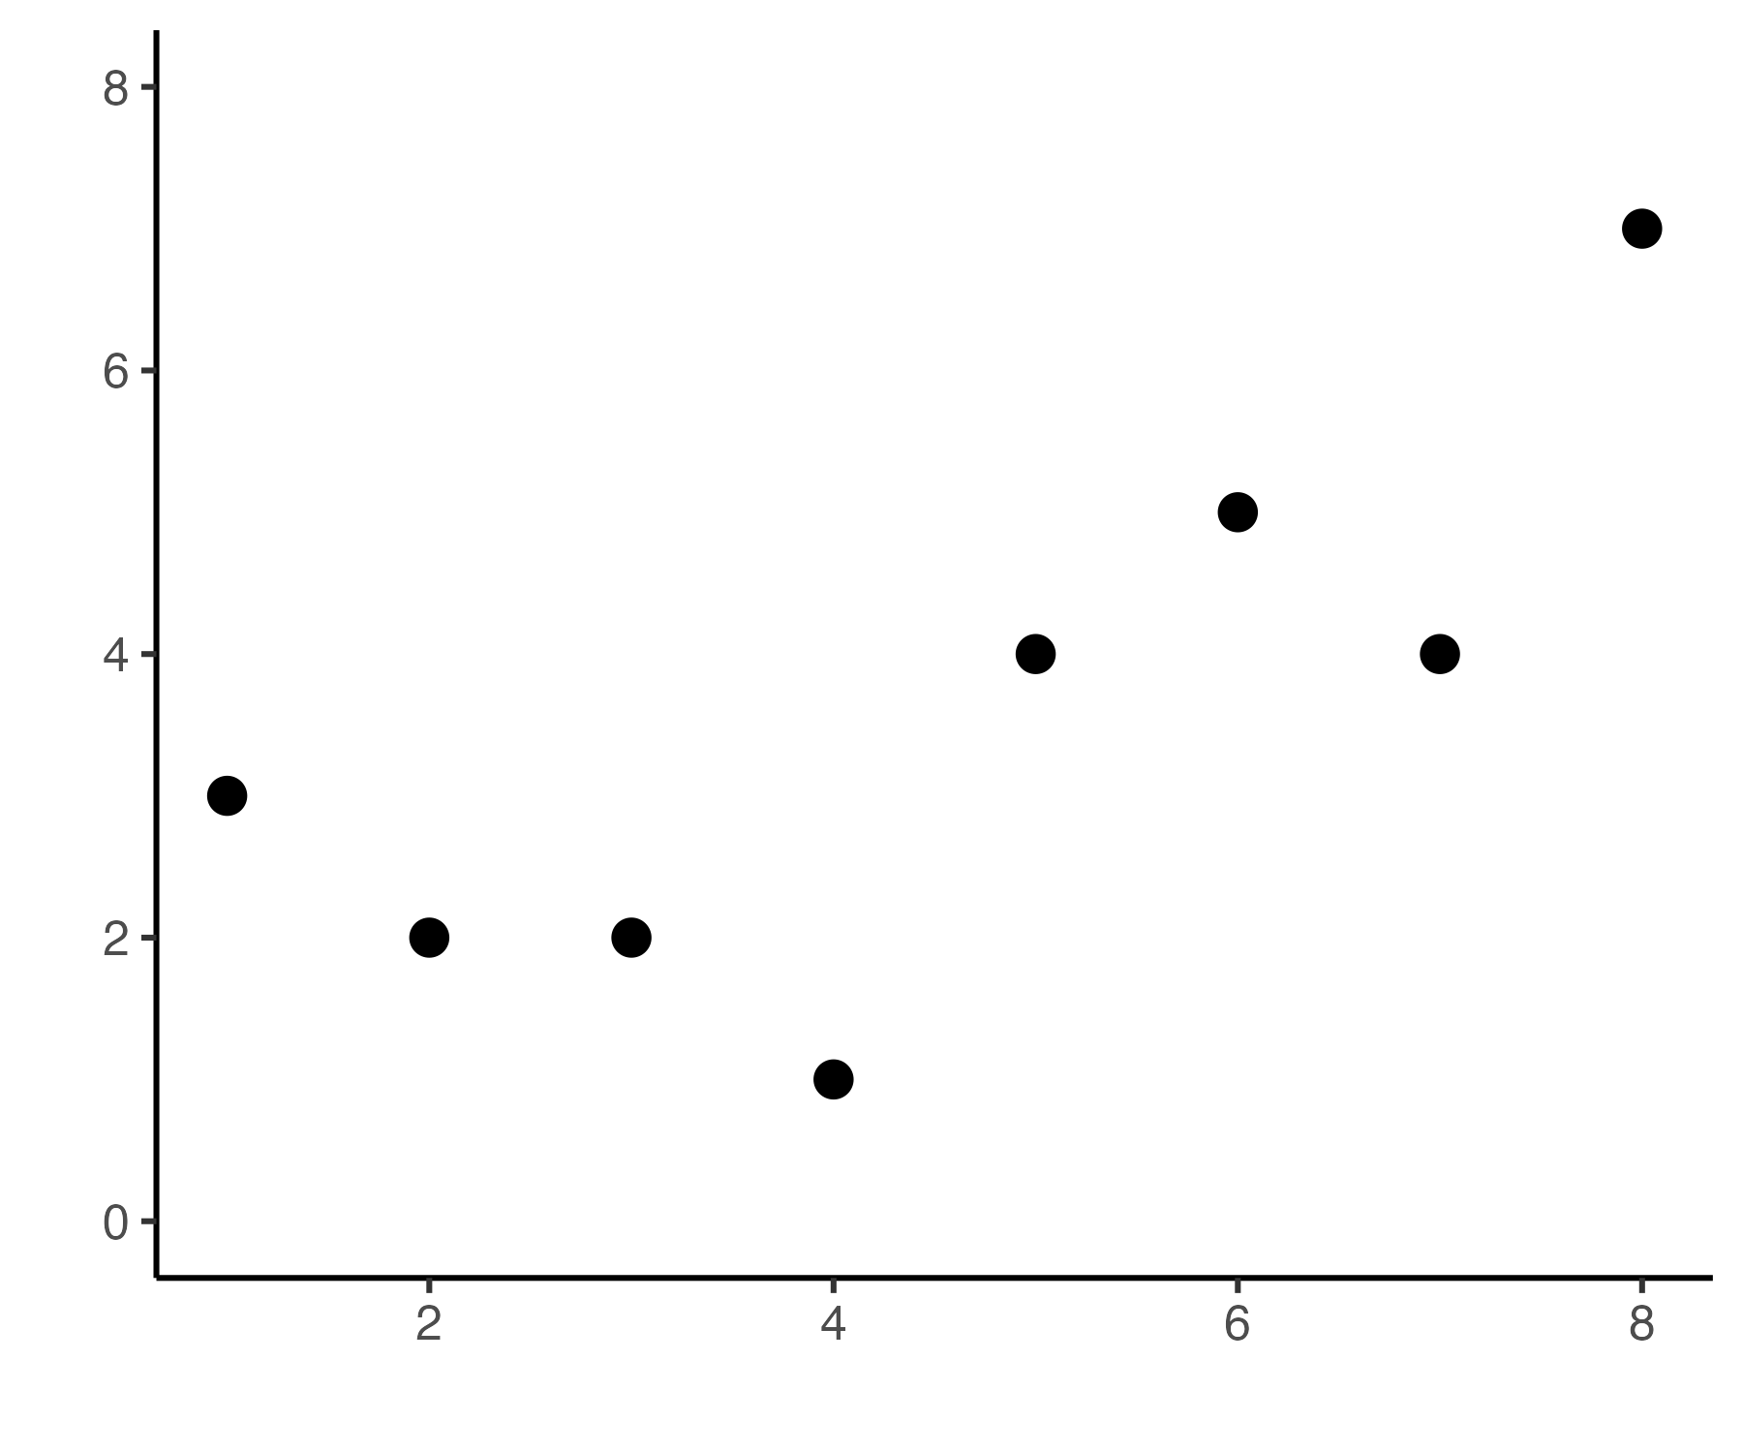
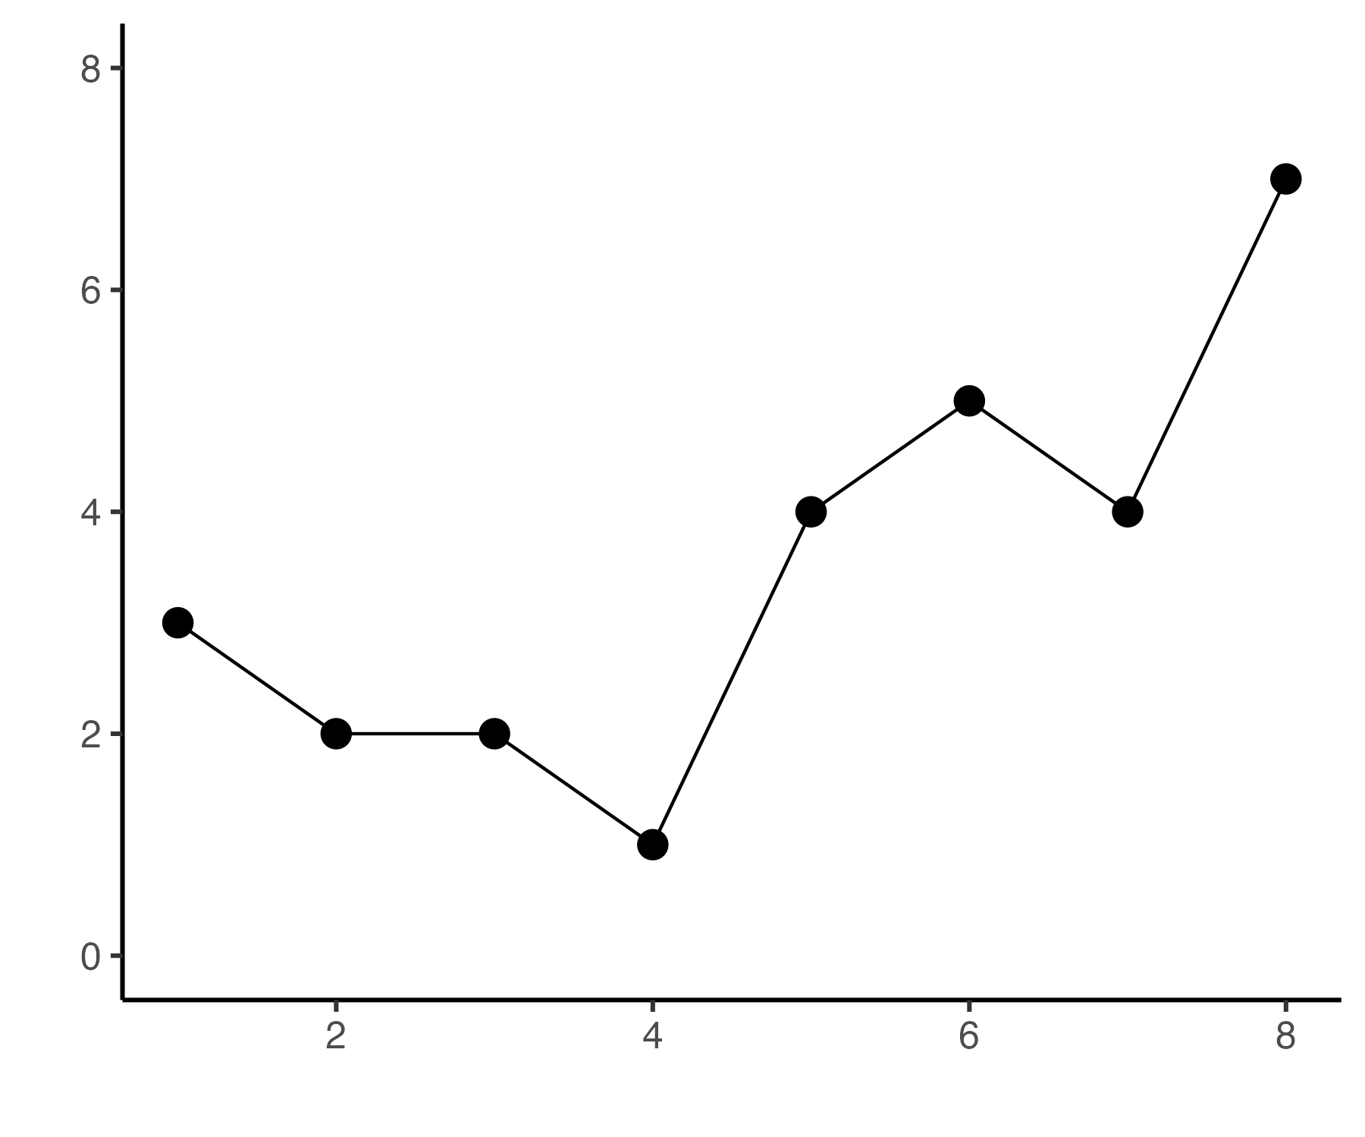
Connection example

Slide 32

Lack of Visual Order

Slide 33
When design is thoughtful, it fades into the background so that your audience doesn’t even notice it.
When its not, however, your audience feels the burden.

Slide 34
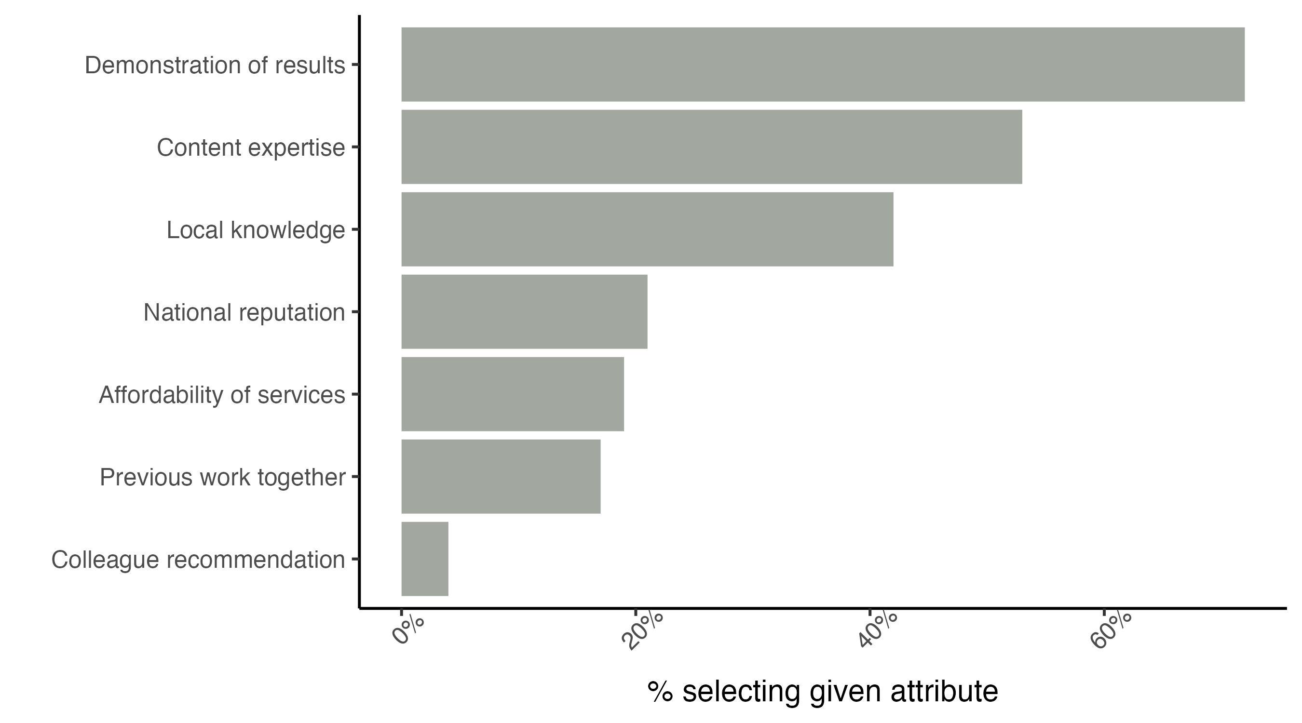
Demonstrating effectiveness is most important consideration when selecting a provider
Survey shows that the demonstration of results is the single most important dimension when choosing a service provider
Affordability and experience working tighter previously, which were hypothesized to be very important in the decision making process, were both cited less frequently as important attributes
This chart isn’t too bad. However, it looks disorganized and uncomfortable to look at. Elements appear placed at random, with no thought.

Slide 35
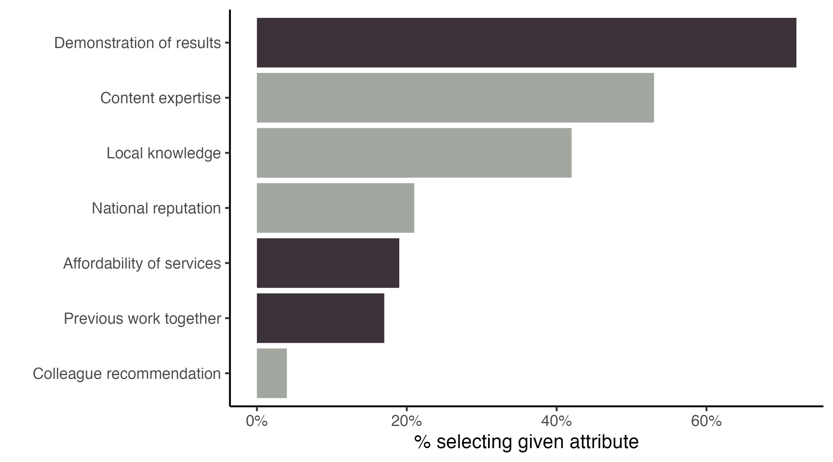
Updated chart
Demonstrating effectiveness is most important consideration when selecting a provider
Survey shows that the demonstration of results is the single most important dimension when choosing a service provider
Affordability and experience working together previously, which were hypothesized to be very important in the decision making process, were both cited less frequently as important attributes
This second iteration feels easier to understand.
It is evident that conscious thought was paid to the design and arrangement of components.
Specifically, more attention was paid to alignment and white space.

Slide 36
alignment
Demonstrating effectiveness is most important consideration when selecting a provider
Centered text does not create clean lines on either side of the text.
Can make a thoughtful design look sloppy.
Does not take advantage of Continuity Gestalt
Survey shows that the demonstration of results is the single most important dimension when choosing a service provider
Affordability and experience working tighter previously, which were hypothesized to be very important in the decision making process, were both cited less frequently as important attributes

Slide 37
Without visual cues, your audience will read in a “Z” pattern, starting in the top left, moving to the right and down.

Slide 38
Diagonal components
Demonstrating effectiveness is most important consideration when selecting a provider
Survey shows that the demonstration of results is the single most important dimension when choosing a service provider
Items rotated at 45 degrees are read up to 52% slower.
Text rotated 90 degrees in either direction are up to 206% slower
Affordability and experience working tighter previously, which were hypothesized to be very important in the decision making process, were both cited less frequently as important attributes

Slide 39
Diagonal components
Demonstrating effectiveness is most important consideration when selecting a provider
Survey shows that the demonstration of results is the single most important dimension when choosing a service provider
These diagonal lines also make things appear messy and will increase the time it takes to read the chart
Affordability and experience working tighter previously, which were hypothesized to be very important in the decision making process, were both cited less frequently as important attributes

Slide 40
Alternative to sight lines
Demonstrating effectiveness is most important consideration when selecting a provider
Survey shows that the demonstration of results is the single most important dimension when choosing a service provider
Affordability and experience working together previously, which were hypothesized to be very important in the decision making process, were both cited less frequently as important attributes
Note that in this revised version, we use color and text elements (bolding, in this case) to tie things together. We could have also used different colors to take it one step further.

Slide 41
White space
White space is blank space on the page.
Blank space should never be filled “just because”
Remember that every additional element on a chart takes cognitive load to process, so white space helps focus your audience.
Guidelines
Margins should remain free of text and visuals
Resist the urge to stretch visuals to take up the available space
If there is only one really important thing, think about making that the only thing on your slide

Slide 42
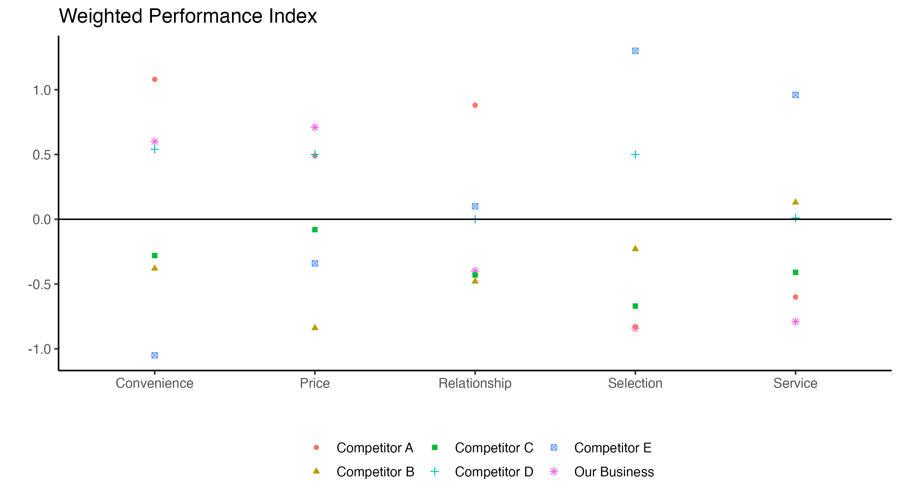
Non-strategic use of contrast
How many contrasting elements are there?
What is their purpose?
How easy is it to understand the insight in this chart?

Slide 43
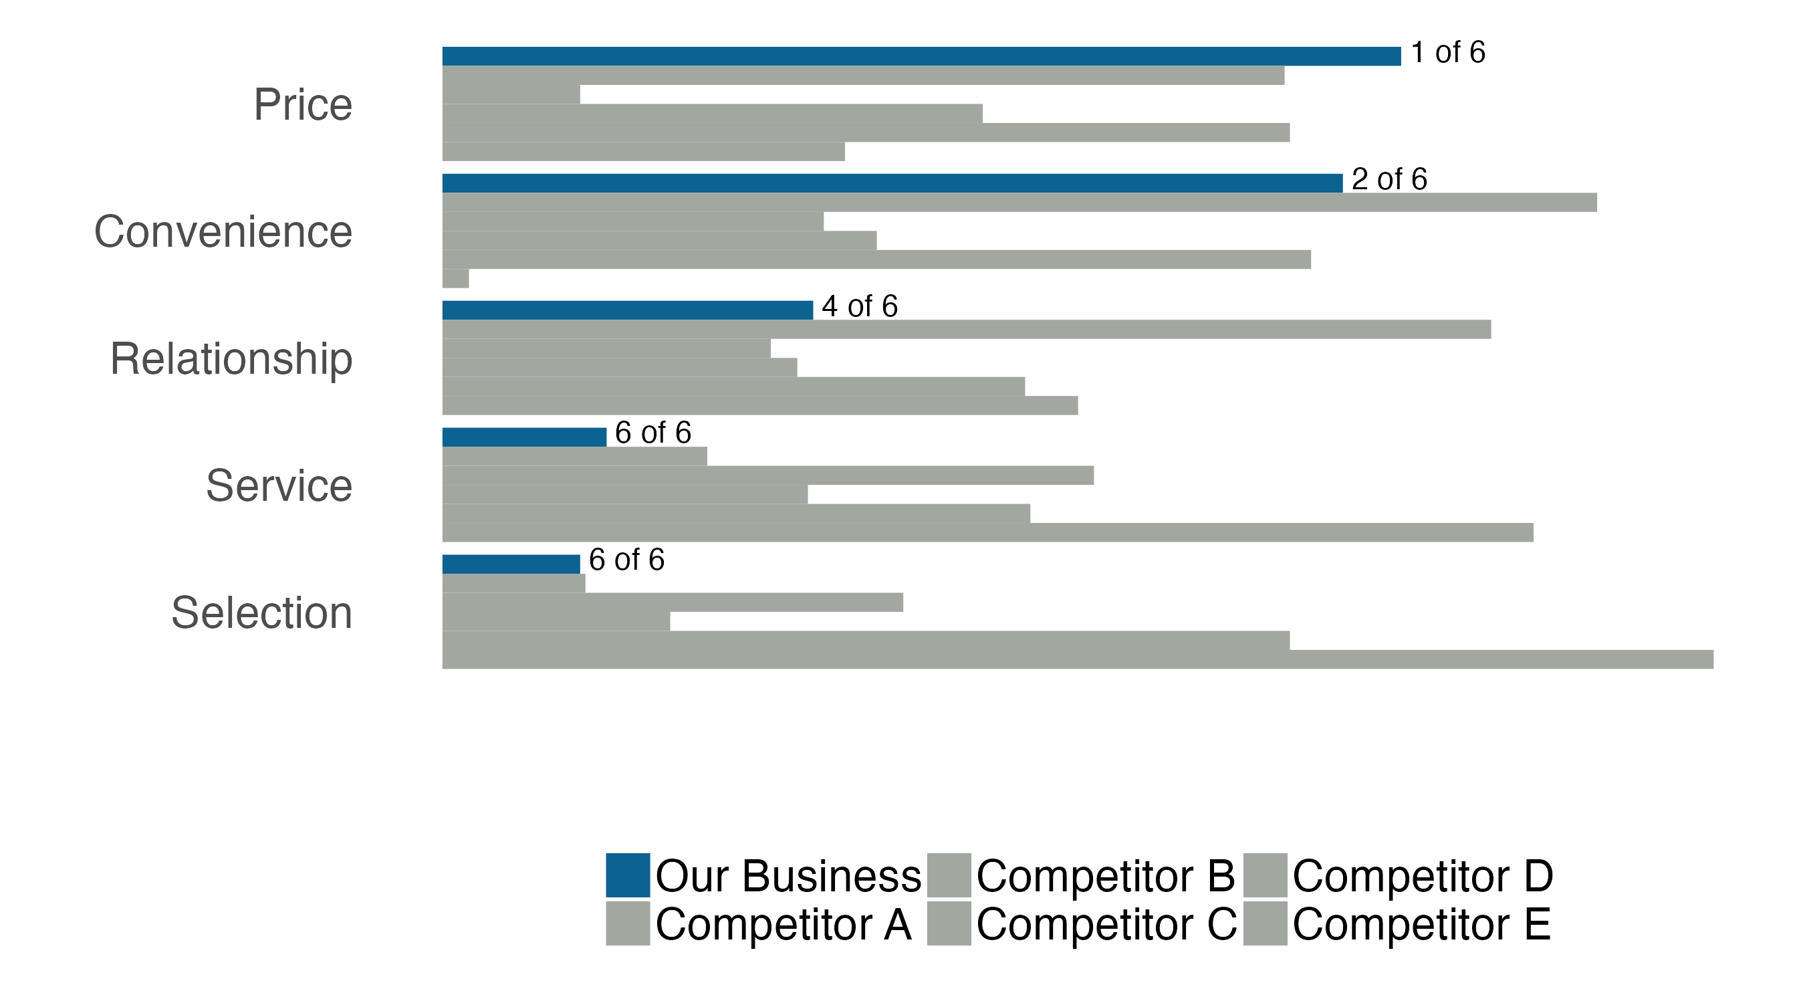
Strategic use of contrast
What changes have been made?
How do they improve the chart?

Slide 44
Strategic use of contrast
Changes:
Chart type updated
Color used to draw the eye
Competitors greyed out to de-emphasize
Use grey to provide context
Add rankings for additional context
Re-base numbers so they are all positive
Remove axes so audience will focus on relative difference

